Slide 1



AUTO SCALE

Slide 2
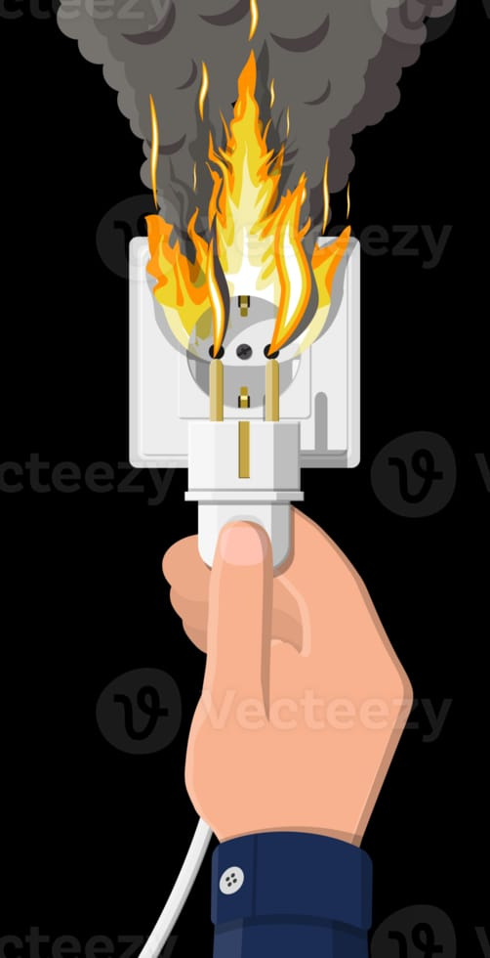
Problem
• Sudden fuse cut-out leads to unexpected power loss
• Electronic devices may get damaged due to abrupt power interruption
• Important tasks can be interrupted or data may be lost
• Difficult to identify the exact cause of fuse failure quickly

Slide 3

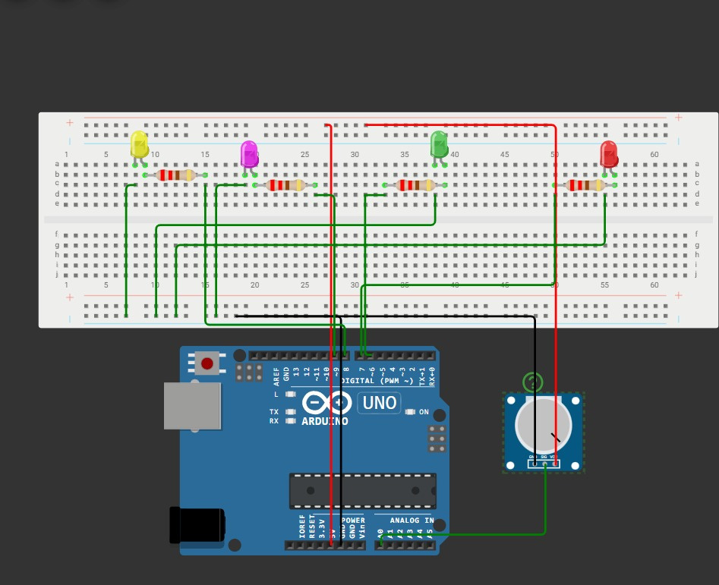
Solution
• Our project is designed to detect electrical overload in a circuit.
• The system continuously monitors the current flowing in the circuit.
• When the current exceeds the safe limit, the system detects an overload condition.
• Instead of cutting all power, the system disconnects non-essential loads.
• This helps keep important devices running while reducing the load.
• The system protects electrical appliances and prevents fuse failure or damage.

Slide 4


ADVANTAGES
• Prevents electrical overload in the circuit
• Protects appliances from damage caused by
excessive devices
• Maintains power to essential devices
• Automatically disconnects non-essential loads
• Improves electrical safety
• Reduces the chance of fuse failure
• Efficient use of available power

Slide 5
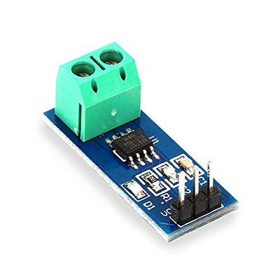
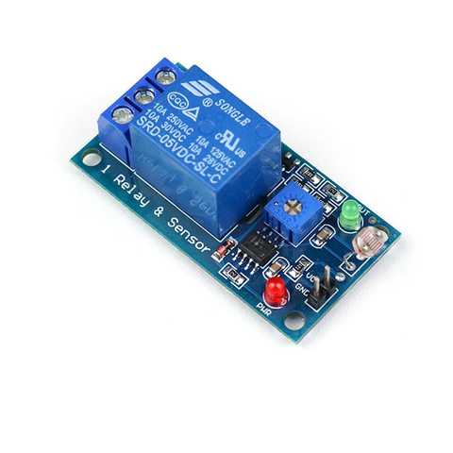
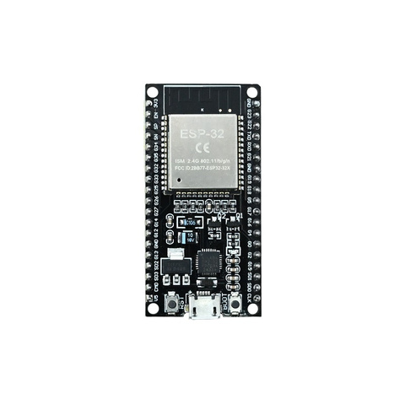
CRITICAL COMPONENTS
ESP-32
ESP32 is used as the main controller to monitor the current and automatically disconnect non-essential loads when an overload is detected.
Current Sensor
Relay Module
The current sensor measures the amount of current flowing in the circuit and sends the data to the ESP32 to detect overload conditions.
The relay module is used to automatically switch off the non-essential loads when the ESP32 detects an overload.

Slide 6

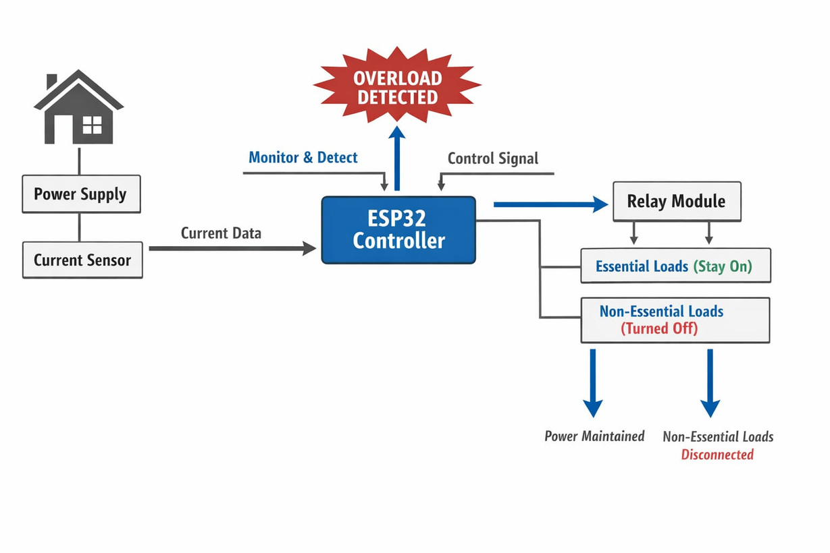

WORKING
Normal case-Code
float current = abs(sensorValue - zeroCurrent) * 0.00049;
Serial.print("Current: ");
Serial.println(current);
if(current > threshold) {
digitalWrite(RELAY_PIN, LOW);
digitalWrite(RED_LED, HIGH);
digitalWrite(GREEN_LED, LOW);
}
else {
digitalWrite(RELAY_PIN, HIGH);
digitalWrite(GREEN_LED, HIGH);
digitalWrite(RED_LED, LOW);
}
delay(300);
}
#define SENSOR_PIN 34
#define RELAY_PIN 25
#define GREEN_LED 26
#define RED_LED 27
float zeroCurrent = 2048;
float threshold = 0.6; // fixed current limit
void setup() {
Serial.begin(115200);
pinMode(RELAY_PIN, OUTPUT);
pinMode(GREEN_LED, OUTPUT);
pinMode(RED_LED, OUTPUT);
digitalWrite(RELAY_PIN, HIGH);
}
void loop() {
int sensorValue = analogRead(SENSOR_PIN);
Hardware
• Current sensor measures current
• Data sent to ESP32
• ESP32 detects overload
• Relay disconnects non-essential loads

Slide 7
WORKING
Overload case-Code
#define SENSOR_PIN 34
#define RELAY_PIN 25
#define GREEN_LED 26
#define RED_LED 27
float zeroCurrent = 2048;
float threshold = 0.2; // fixed current limit
void setup() {
Serial.begin(115200);
pinMode(RELAY_PIN, OUTPUT);
pinMode(GREEN_LED, OUTPUT);
pinMode(RED_LED, OUTPUT);
digitalWrite(RELAY_PIN, HIGH);
}
void loop() {
int sensorValue = analogRead(SENSOR_PIN);
float current = abs(sensorValue - zeroCurrent) * 0.00049;
Serial.print("Current: ");
Serial.println(current);
if(current > threshold) {
digitalWrite(RELAY_PIN, LOW);
digitalWrite(RED_LED, HIGH);
digitalWrite(GREEN_LED, LOW);
}
else {
digitalWrite(RELAY_PIN, HIGH);
digitalWrite(GREEN_LED, HIGH);
digitalWrite(RED_LED, LOW);
}
delay(300);
}

Slide 8


LIMITATIONS
• Smart homes can optimize power usage more intelligently than basic overload systems.
• Our system currently focuses mainly on overload protection rather than full smart automation.
• Traditional analog protection systems (like circuit breakers and overload relays) already provide basic overload protection.
• Integration with existing electrical and smart home systems may require further development.

Slide 9

FUTURE SCOPES
• Development of mobile app monitoring to track power usage remotely.
• Adding AI or smart algorithms to automatically prioritize essential appliances.
• Better energy management by analysing usage patterns.
• Integration with renewable energy sources like solar power systems.
• Improving the system to predict overload conditions before they occur.
• Expanding the system for larger buildings and industrial applications.

Slide 10
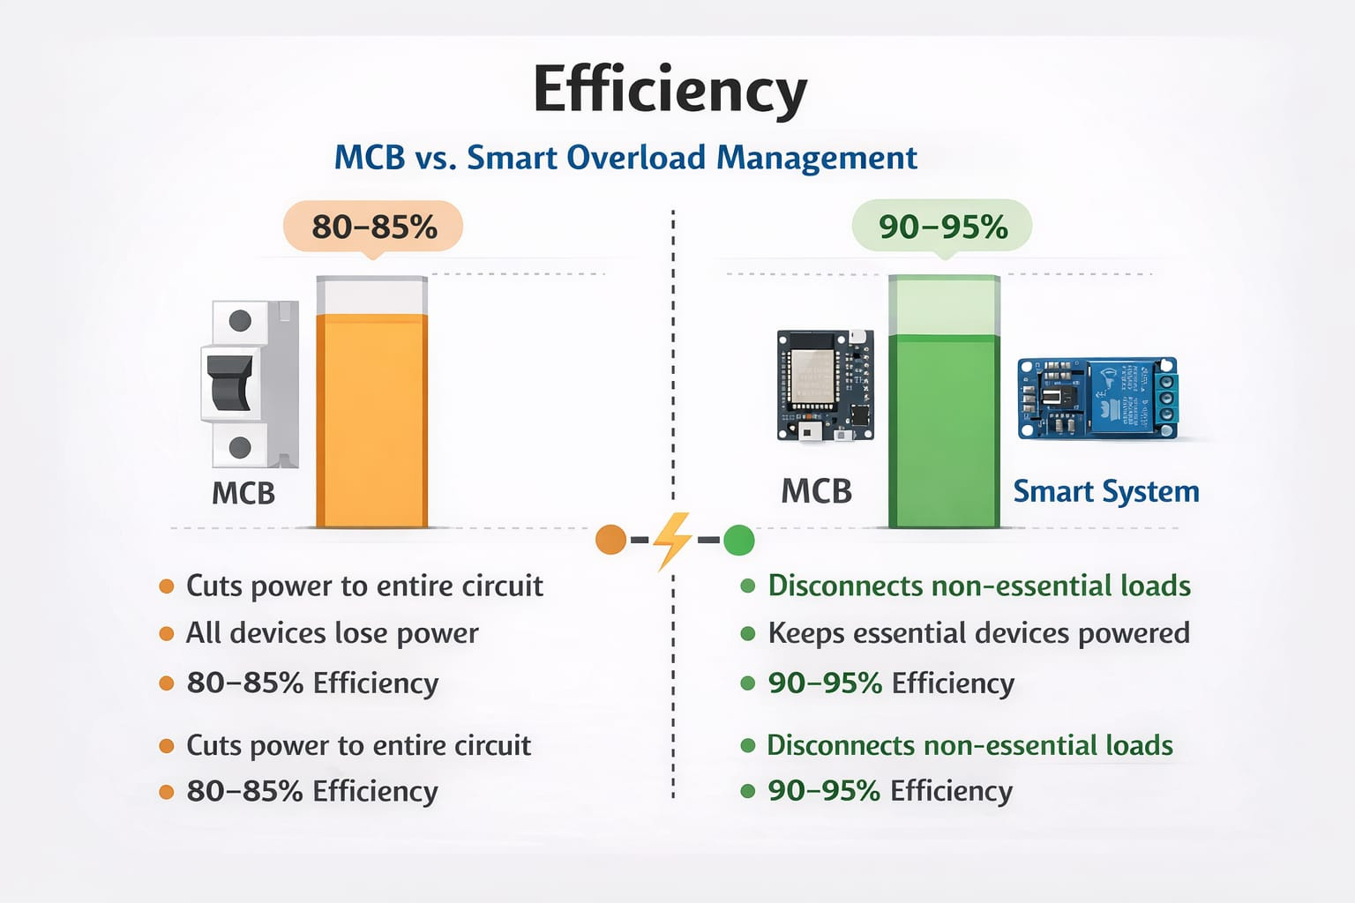
Efficiency
• A traditional MCB typically provides about 80–85% efficiency in managing overload, since it cuts power to the entire circuit, stopping all devices.
• Our system can achieve around 90–95% efficiency because it disconnects only non-essential loads while keeping essential devices powered.
• This selective load control improves overall power utilization.
• The use of ESP32 and a current sensor allows faster detection and response to overload conditions.
• As a result, the system maintains better continuity of power for important appliances compared to a standard MCB

Slide 11

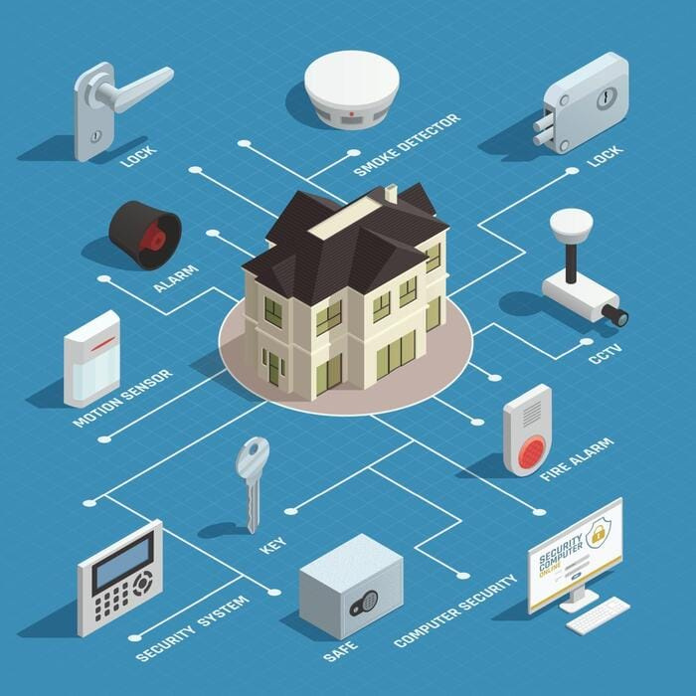

CONCLUSION
• This project provides a simple and effective solution for managing electrical overload.
• It protects appliances and circuits from damage caused by excessive current.
• The design improves electrical safety and power management.
• By disconnecting non-essential loads, the system ensures that essential devices continue to receive power.
• With further development, the system can be integrated with smart home technologies for better automation.

Slide 12


Thank You

